Slide 1
Historic Preservation Commission August 16, 2021
State Authority
CHAPTER 16. HISTORIC PRESERVATION DISTRICTS
PART I. GENERAL PROVISIONS
§731. Purpose
The purpose of this Chapter is to promote the educational, cultural, economic and general welfare of the public through the preservation and protection of buildings, sites, monuments, structures and areas of historic interest or importance through their protection, maintenance and development as historic landmarks and their recognition as such in the history and traditions of the state and nation; to establish and improve property values, and to foster the economic development of the areas affected.
Acts 1970, No. 147, §1. Amended by Acts 1975, No. 804, §1.
Local Authority
Sec. 5-307. - Historic districts and historic landmarks.
(1)
Purposes. It is the purpose of the provisions of this section related to Historic Districts, Charpentier District, and Margaret Place District to recognize, preserve, and protect the cultural and historic resources of the City of Lake Charles by preserving individual landmarks and maintaining and fostering development in areas within the city of special significance to the history and tradition of the city and the region

Slide 2
Historic Preservation Commission
ANY PERSON MAY SPEAK OR SUBMIT A WRITTEN STATEMENT FOR HEARING PURPOSES.
THE APPLICATION AND SUPPORTING MATERIAL IS ON FILE AND OPEN FOR PUBLIC INSPECTION IN THE OFFICE OF ZONING AND LAND USE,
Location of the office is stated below:
7TH FLOOR OF LAKE CHARLES CITY HALL AT 326 PUJO STREET, LAKE CHARLES, LOUISIANA; OR,
MAIL TO THE CITY OF LAKE CHARLES, OFFICE OF ZONING & LAND USE, P.O. BOX 900, LAKE CHARLES, LA 70602; OR
TELEPHONE: (337) 491-1542.

Slide 3
Criteria for Approval of a Certificate of Appropriateness
In considering an application for a Certificate of Appropriateness, the Historic Preservation Commission shall be guided by any adopted design guidelines, and where applicable, the Secretary of the Interior's Standards for Rehabilitation of Historic Buildings.
These documents shall be made available to the property owners of historic landmarks or within historic districts.

Slide 4
Appeals to City Council
An applicant for a Certificate of Appropriateness, or any City Council member, dissatisfied with the action of the Historic Preservation Commission relating to the issuance or denial of a Certificate of Appropriateness shall have the right to appeal to the City Council within 15 days after receipt of notification of such action.
The City Council shall give notice, follow publication procedures, hold hearings, and make its decision in the same manner as provided in the general zoning ordinance of the city. In hearing an appeal, the City Council shall determine whether the proposed work is consistent with the regulations, standards, and design guidelines contained in this Ordinance.

Slide 5
Announcements
Discussion relocation of St Louis Catholic School
NPS LA CRT CLG “Harvey Grant” - Survey Update: Grant award $100,000, SOI qualified consultant Sara Hahn of Coastal Environmental
CLG grant Digitization Update Completed Will be working with 1911 City Hall, Chuck Fest and others on the roll out this fall
Overview of Hurricane recovery, property data and administrative reviews
Updates Central School – Bids received, Tenant coordination in progress
Updates 1911 Old City Hall – RFQ for qualified Bidders

Slide 6
HPC 21-15 LAKE CHARLES ZONING ORDINANCE CO. 10598
APPLICANT: 703 MILL STREET DAVID BURNETT
SUBJECT: Applicant is requesting a Certificate of Appropriateness (Section 5-307) (15) by the Historic Preservation Commission to renovate damage from Hurricane Laura. Windows, Siding, Doors, Porch Columns, Porch railings, House addition at 703 MILL ST. Neighborhood Zoning – Contributing Element
STAFF FINDINGS: The on-site and site plan reviews revealed that the applicant requests to restore, renovate and repair damage from Hurricane Laura. Windows, Siding, Doors, Porch Columns, Porch railings, and a house addition will be included. Custom mill work, window repairs, siding and columns will be incorporated. The addition will replace areas severely damaged enhance access and will allow modernization of the kitchen areas. The owner has received administrative approvals for partial demo to investigate neglect and damages, to reveal original and repair roof and foundations. 703 MILL ST. Neighborhood Zoning – Contributing Element

Slide 7
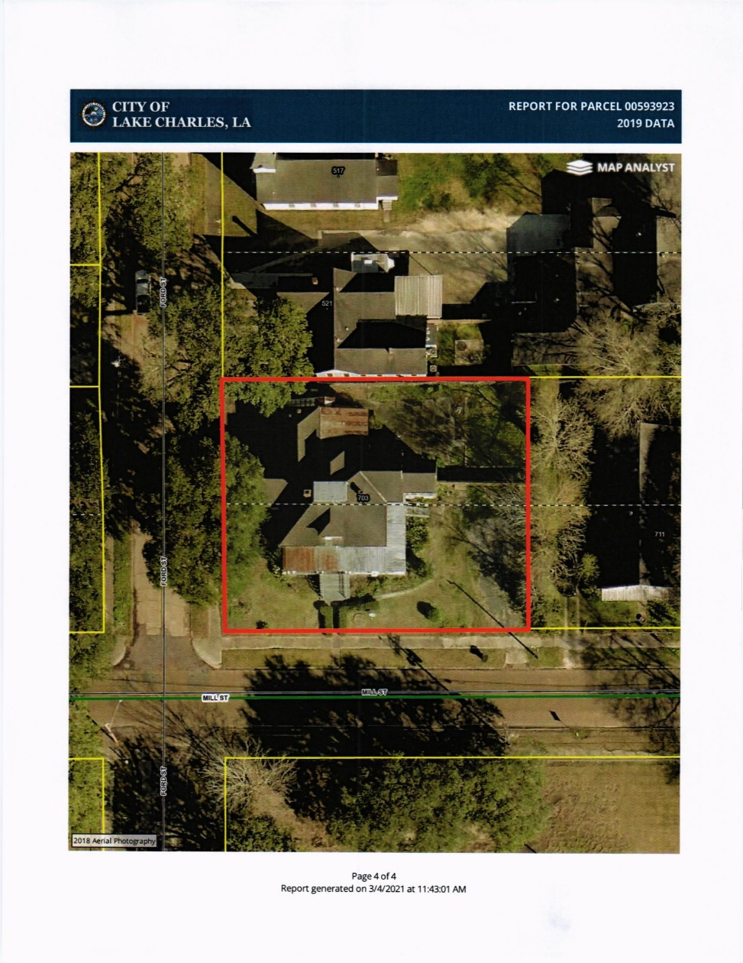
HPC 21-15 703 MILL STREET – DAVID BURNETT

Slide 8
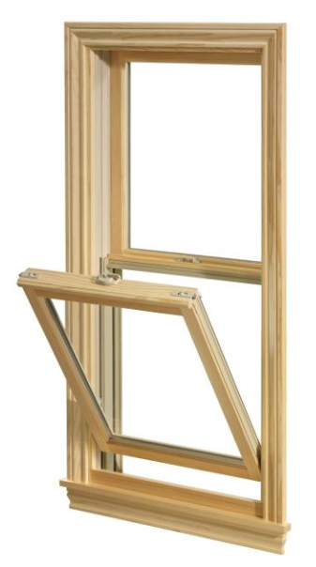
HPC 21-15 703 MILL STREET DAVID BURNETT Letter of Intent
1. Windows – The proposed windows will be custom milled, all wood single pane windows. These will match existing -like for like -windows. It is proposed to use wavy glass in the single pane fabrication of the windows. The vendor indicated wavy glass was available (TBD). The locations of the windows are indicated on the shop drawings (attached). Both new and existing windows are referenced.
There will be some windows where the 12-pane over single will not be applicable, ie, the bay window in shown below.

Slide 9
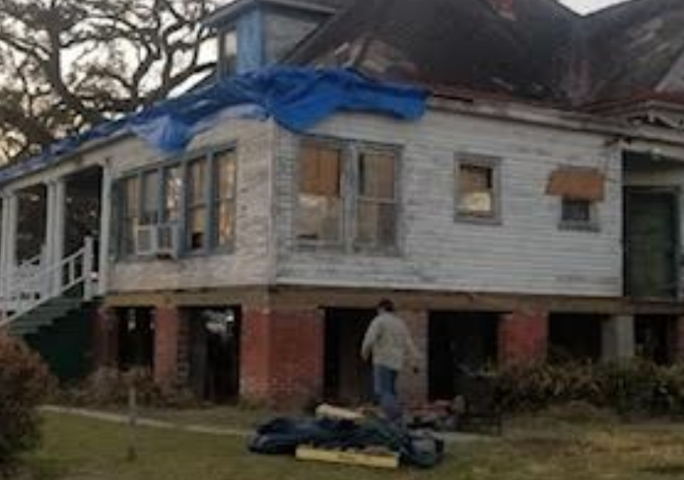
HPC 21-15 703 MILL STREET DAVID BURNETT Letter of Intent
2. Siding – The original siding ship lap is shown. The proposed replacement siding shiplap will be milled to replicate existing 1”x4” custom wedge siding. The proposed material is cypress.

Slide 10
HPC 21-15 703 MILL STREET DAVID BURNETT Letter of Intent
3. Doors
It is proposed existing doors will be removed and refurbished and then reinstalled. It is proposed all doors will be refurbished unless a specific door is beyond repair. Any replacement door will be of same design and material.

Slide 11
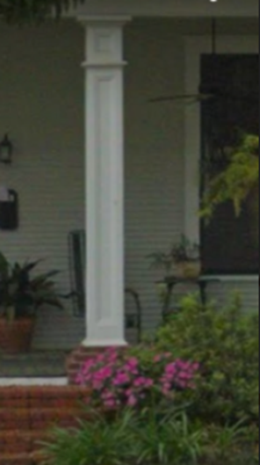
HPC 21-15 703 MILL STREET DAVID BURNETT Letter of Intent
4. Porch Columns
It is understood the original construction of the property had a partial wrap around porch. Later in time part of the wrap around porch was converted to living space. It is proposed the original configuration of the porch will be reinstated. In order to accomplish this ten (10) new columns are required. It is proposed the design of the columns will be fabricated from solid wood coated with a quality paint. picture shows the design. Column will not have the brick base , the column base will extend from the porch surface.

Slide 12
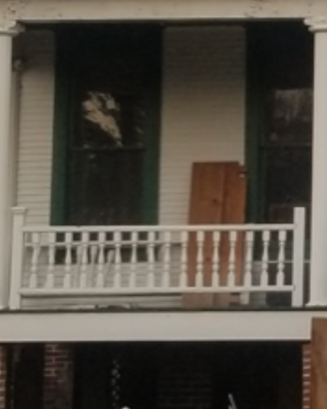
HPC 21-15 703 MILL STREET DAVID BURNETT Letter of Intent
5. Porch Railings
It is proposed the porch railings will be connected directly into the new porch columns. The railing depicted in the picture below will be removed. The replacement railings will be simple straight edges.

Slide 13
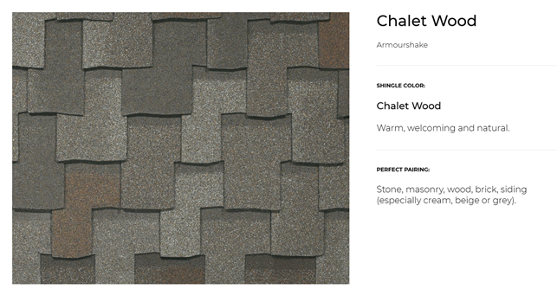
HPC 21-15 703 MILL STREET DAVID BURNETT Letter of Intent
6. House Addition
It is proposed the house addition will be constructed with windows and siding as depicted above. It is understood the construction and appearance will be same as original construction.
7. Roof
The roofing will be a simulated Wood shake shingle with IKO armor shake. It will have the barrel tile edges
8. The front staircase

Slide 14
HPC 21-15 703 MILL STREET – DAVID BURNETT

Slide 15
HPC 21-15 703 MILL STREET – DAVID BURNETT

Slide 16
HPC 21-15 703 MILL STREET – DAVID BURNETT

Slide 17
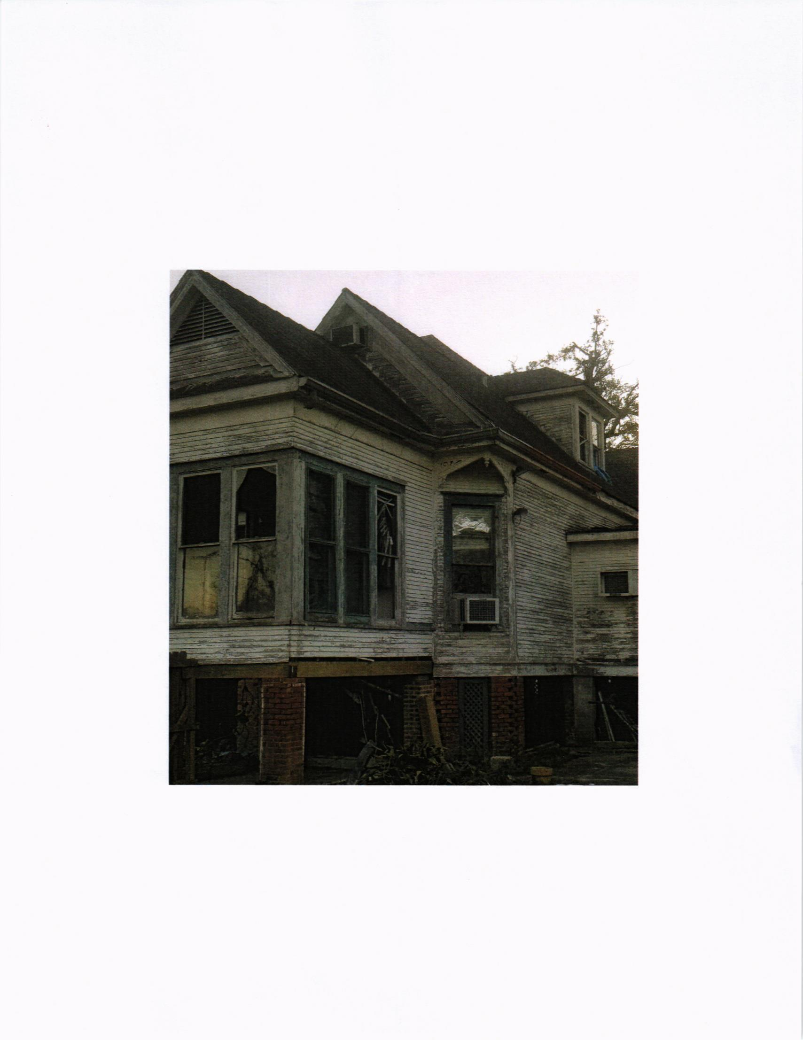
HPC 21-15 703 MILL STREET – DAVID BURNETT

Slide 18
HPC 21-15 703 MILL ST. – DAVID BURNETT SITE PLAN – FLOOR PLAN

Slide 19
HPC 21-15 703 MILL ST. – DAVID BURNETT SOUTH – WEST SIDE PLANS

Slide 20
HPC 21-15 703 MILL ST. – DAVID BURNETT NORTH – EAST SIDE PLANS

Slide 21
BUILDING MATERIAL SCHEDULE

Slide 22
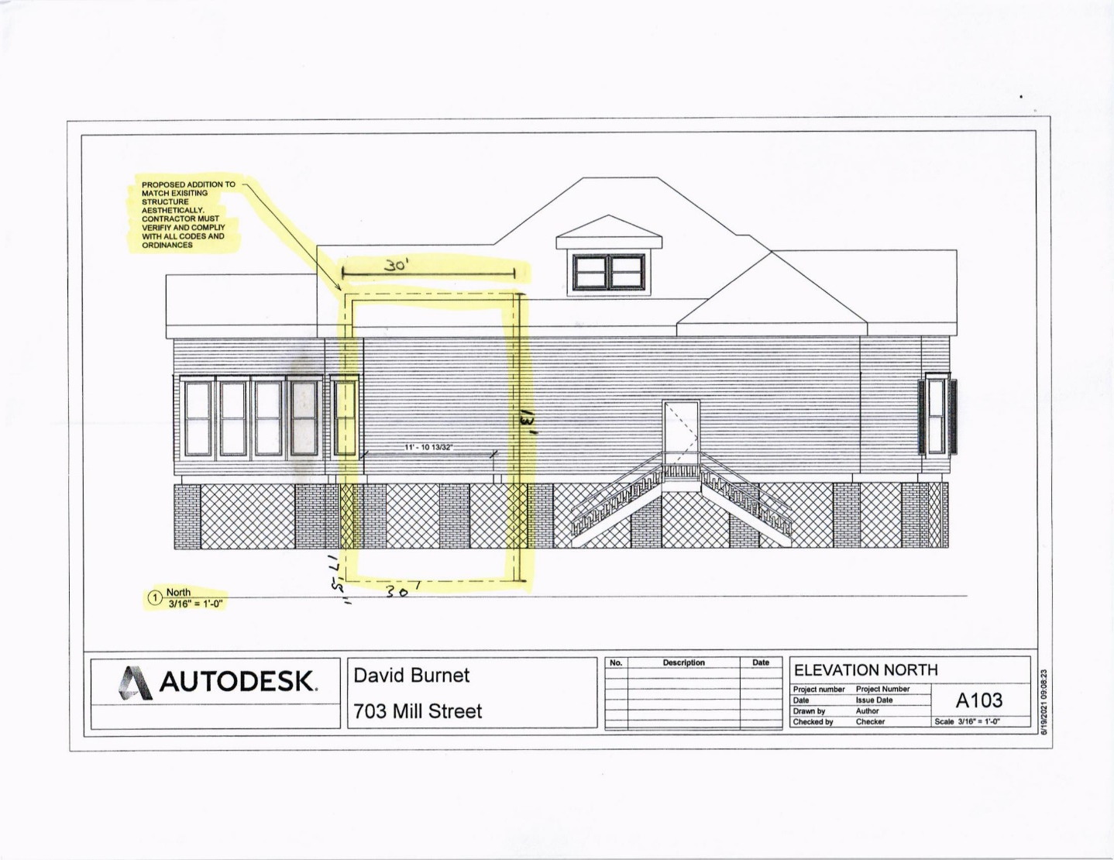
HPC 21-15 703 MILL ST. – BURNETT SITE PLAN & WEST FACADE

Slide 23
HPC 21-15 703 MILL ST. – BURNETT NORTH & EAST FACADE

Slide 24
HPC 21-15 703 MILL ST. – BURNETT SITE PLAN

Slide 25
HPC 21-18 317 Bilbo St
HPC 21-18 LAKE CHARLES ZONING ORDINANCE CO. 10598
APPLICANT: 317 BILBO STREET ANTONIO VARGAS
SUBJECT: Applicant is requesting a Certificate of Appropriateness (Section 5-307) (15) by the Historic Preservation Commission to repair damage from Hurricane Laura. Front Porch, rebuild Columns, salvage or match brick column, siding, roof and windows at 317 BILBO ST, T-4 DDA Zoning .
STAFF FINDINGS: The on-site and site plan reviews revealed that the applicant requests to rebuild Front Porch, rebuild Columns, salvage or match brick column, siding, roof and windows. Administrative partial demolition was issued to investigate conditions of damage, the applicant will rebuild with one less window on the South facing façade. 317 BILBO ST, T-4 DDA Zoning.

Slide 26
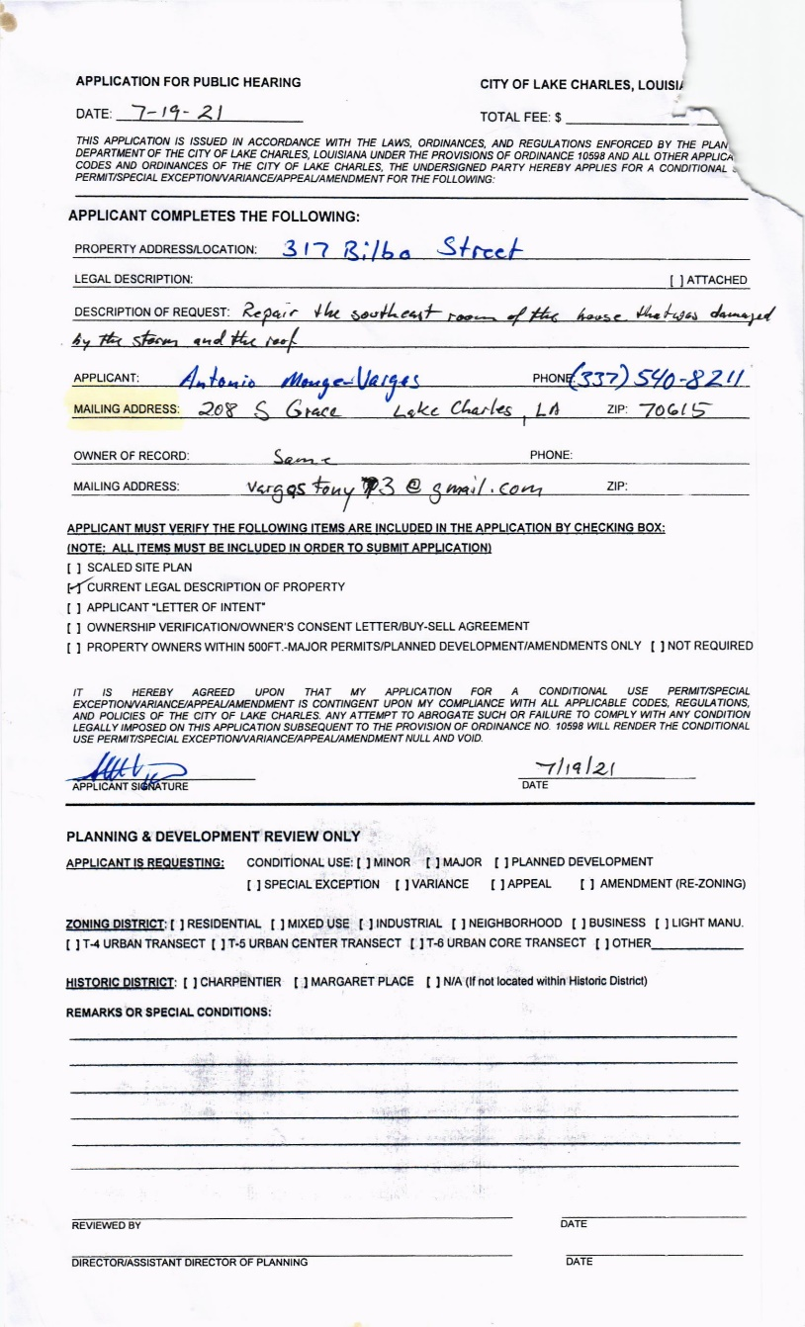
HPC 21-18 317 Bilbo St - APPLICATION - VARGAS

Slide 27
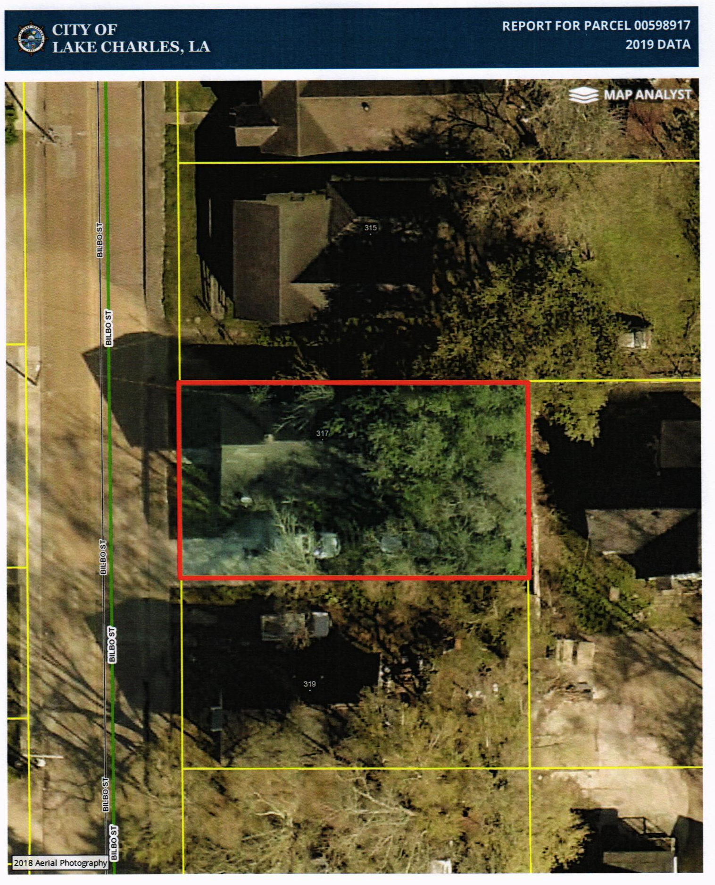
HPC 21-18 317 Bilbo St - GIS

Slide 28
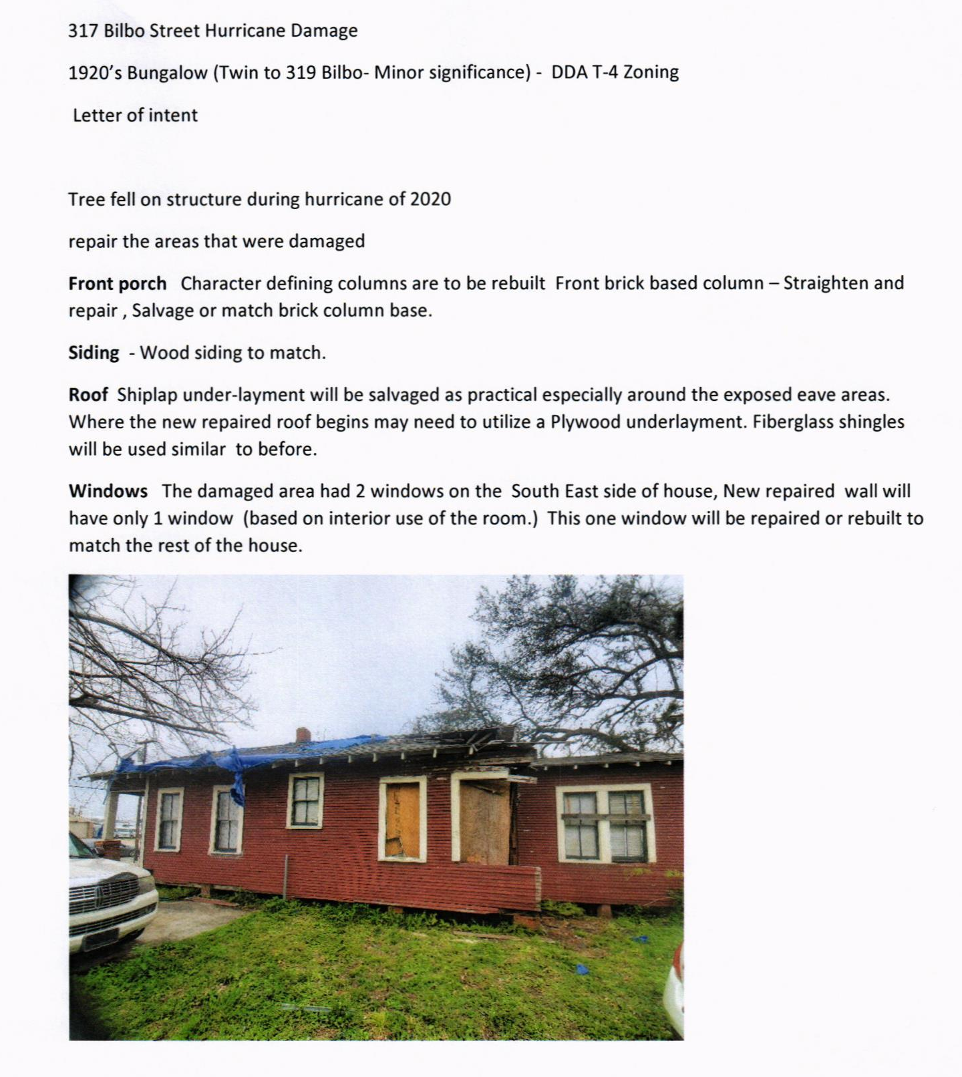
HPC 21-18 317 Bilbo St

Slide 29
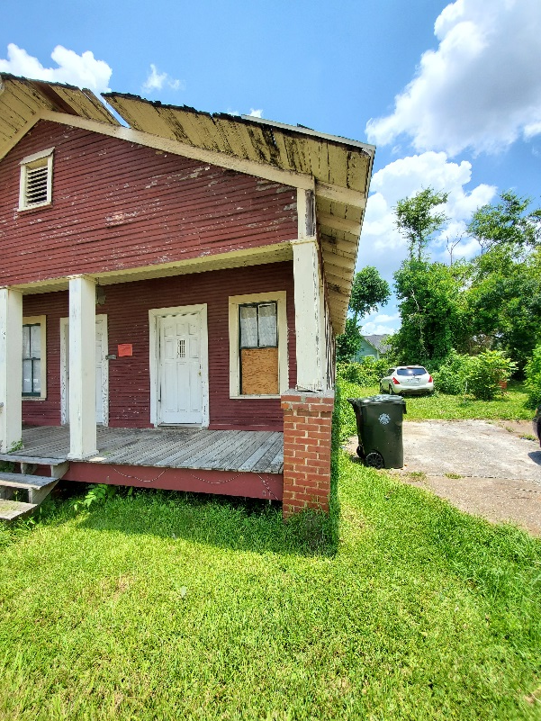
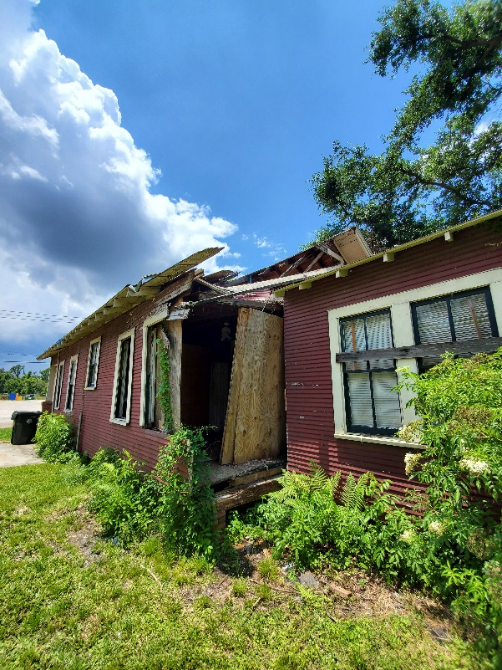
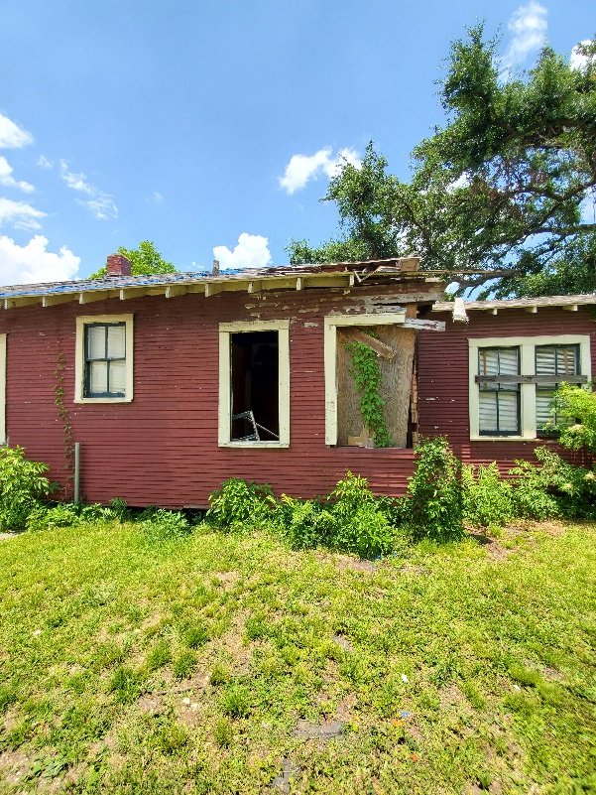
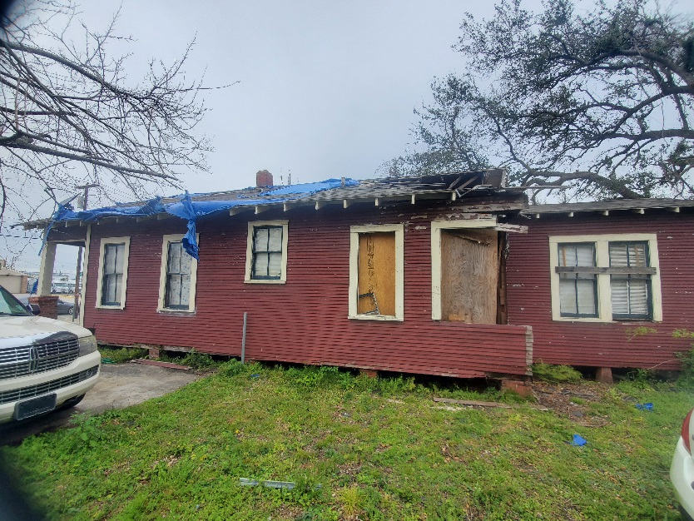
HPC 21-18 317 Bilbo St

Slide 30
HPC 21-18 328 HODGES - NATHANIEL BRYANT
HPC 21-19 LAKE CHARLES ZONING ORDINANCE CO. 10598
APPLICANT: 328 HODGES STREET NATHANIEL BRYANT
SUBJECT: Applicant is requesting a Certificate of Appropriateness (Section 5-307) (15) by the Historic Preservation Commission to replace windows that were damaged during Hurricane Laura. Six (6) windows on East side, Six (6) on South side, Four (4) on North side, two (2) on West side of the house. Recasting and dressing the front porch at 328 HODGES ST. Neighborhood Zoning
STAFF FINDINGS: The on-site and site plan reviews revealed that the applicant requests to Six (6) windows on East side, Six (6) on South side, Four (4) on North side, two (2) on West side of the house. Recasting and dressing the front porch at 328 HODGES ST. Neighborhood Zoning

Slide 31
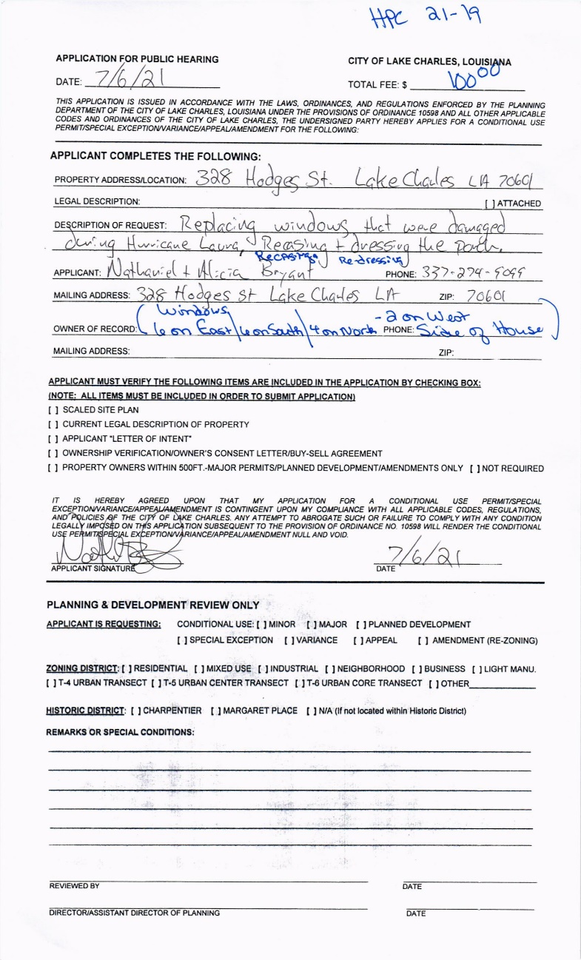
HPC 21-18 328 HODGES ST – BRYANT – APPLICATION

Slide 32
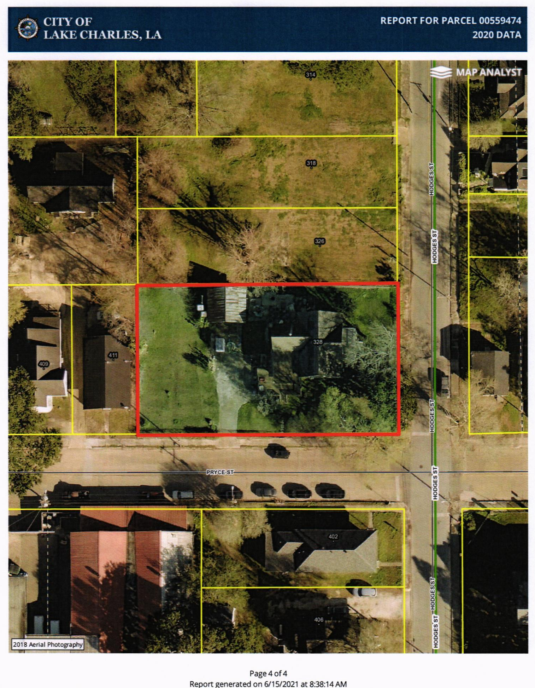
HPC 21-18 328 HODGES ST - NATHANIEL BRYANT - GIS

Slide 33
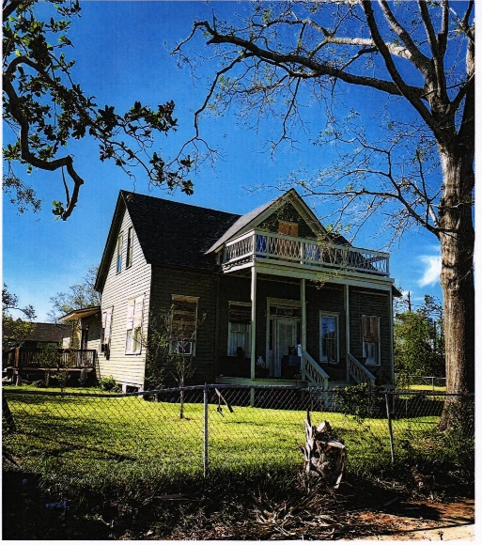
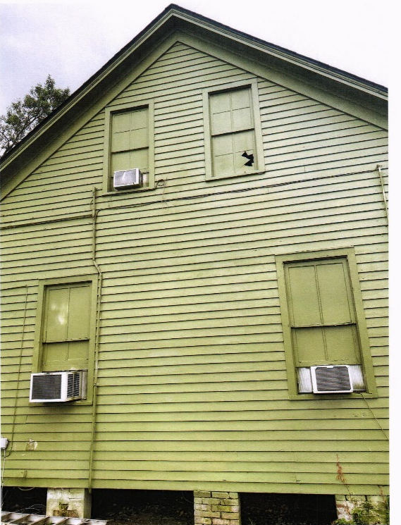
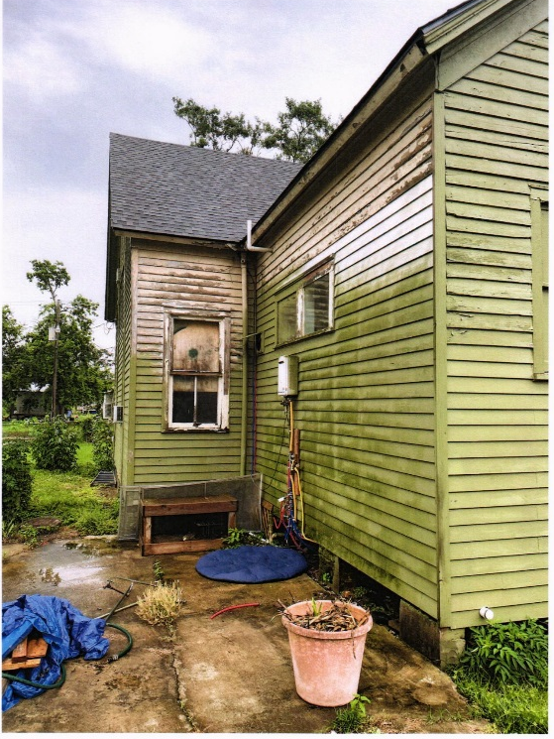
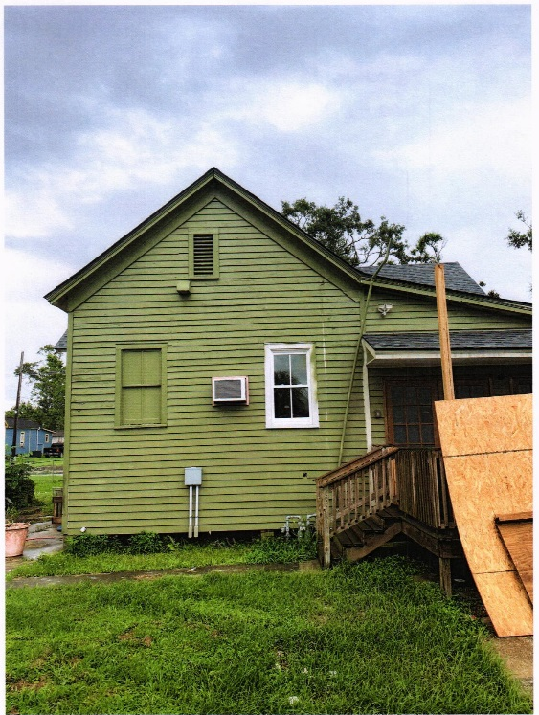
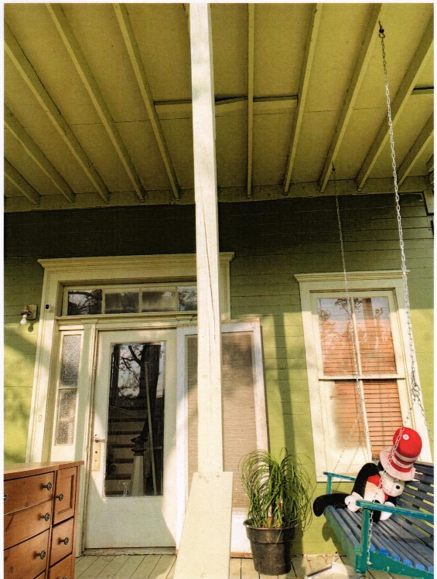
Window replacements 6 on East, 6 on South, 4 on North, 2 on West

Slide 34
HPC 21-18 328 HODGES ST - NATHANIEL BRYANT

Slide 35
HPC 21-18 328 HODGES ST - NATHANIEL BRYANT

Slide 36
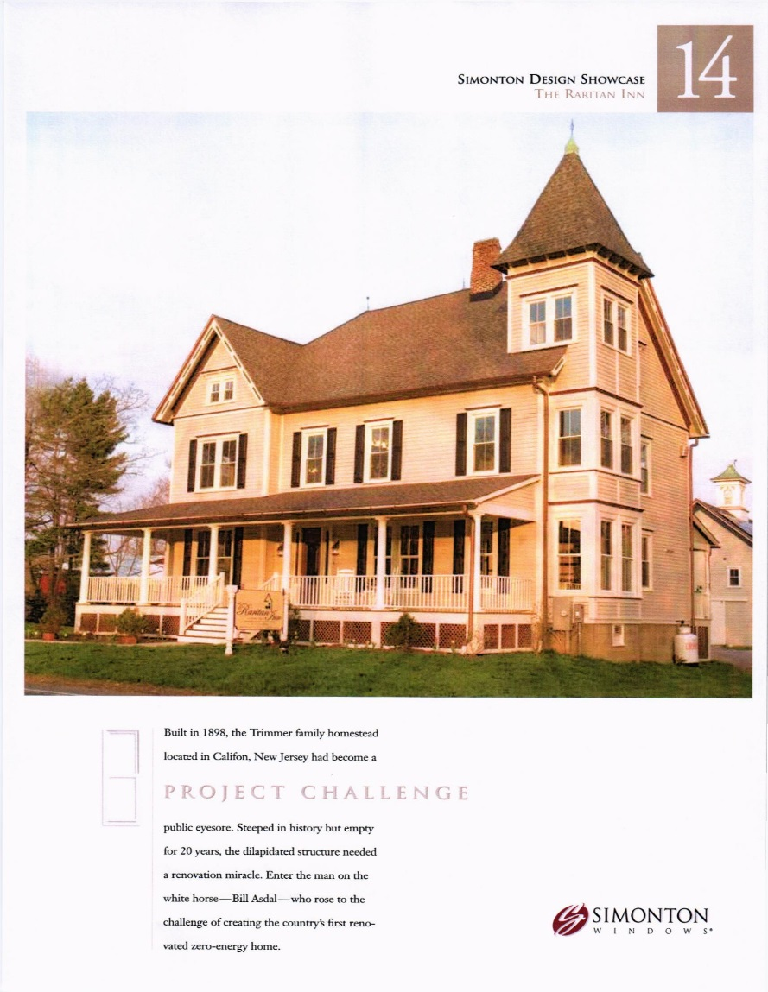
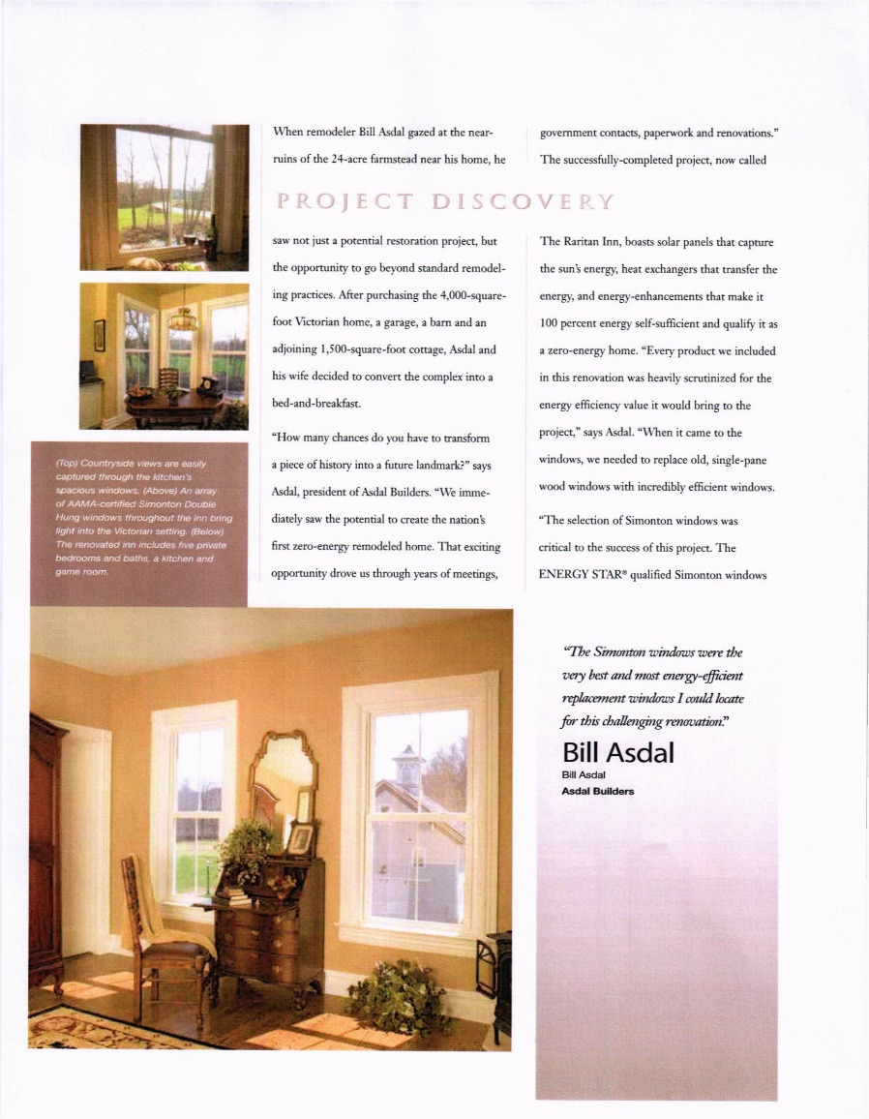
Window Specifications

Slide 37
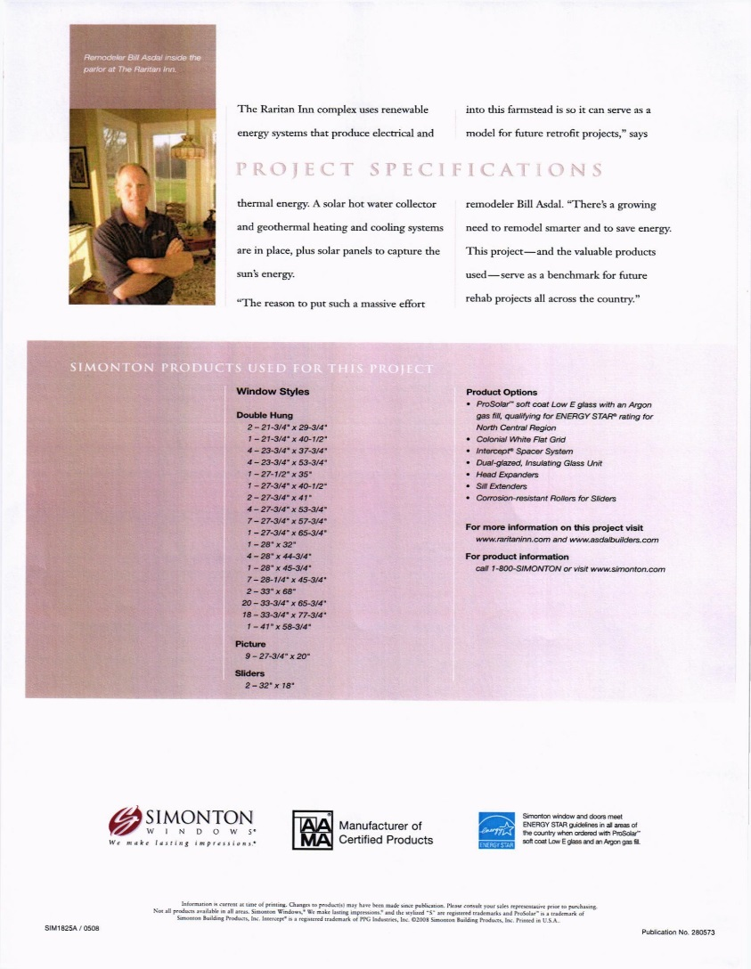
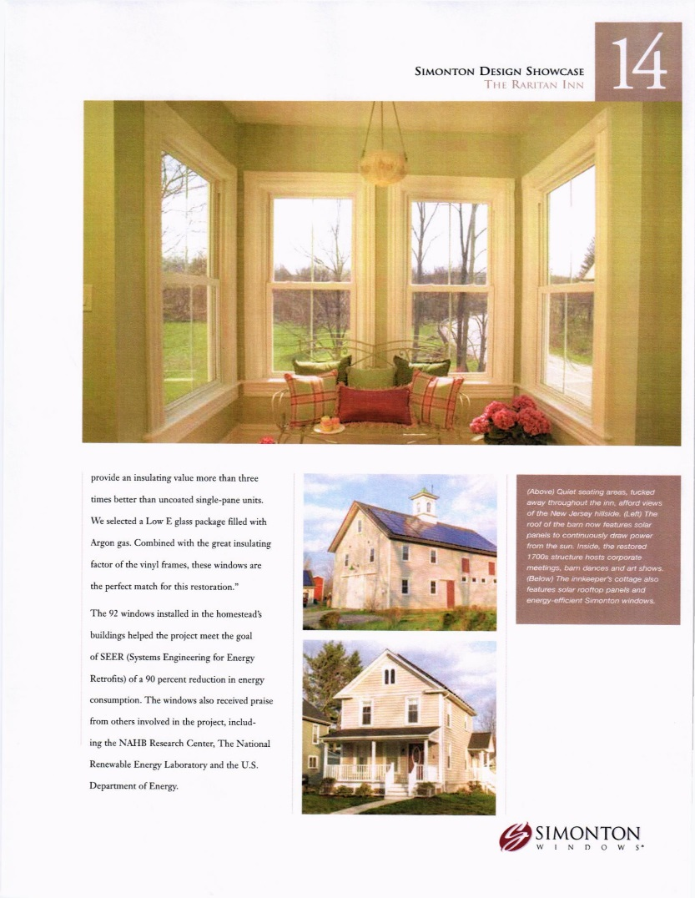
HPC 21-18 328 HODGES ST – BRYANT - WINDOWS

Slide 38
HPC 21-20 LAKE CHARLES ZONING ORDINANCE CO. 10598
APPLICANT: 811 PUJO ST ROY & EJ WASHINGTON
SUBJECT: Applicant is requesting a Certificate of Appropriateness (Section 5-307) (15) by the Historic Preservation Commission in order add a master suite on 1st floor north side of existing structure at 811 Pujo St. Business Zoning - Minor Conditional Use required
STAFF FINDINGS: The on-site and site plan reviews revealed that the applicant requests to add a master suite on 1st floor north side of existing structure
811 Pujo St. Business Zoning - Minor Conditional Use. Must adhere to requirements in Section 5-304 (3) a.(ii)

Slide 39
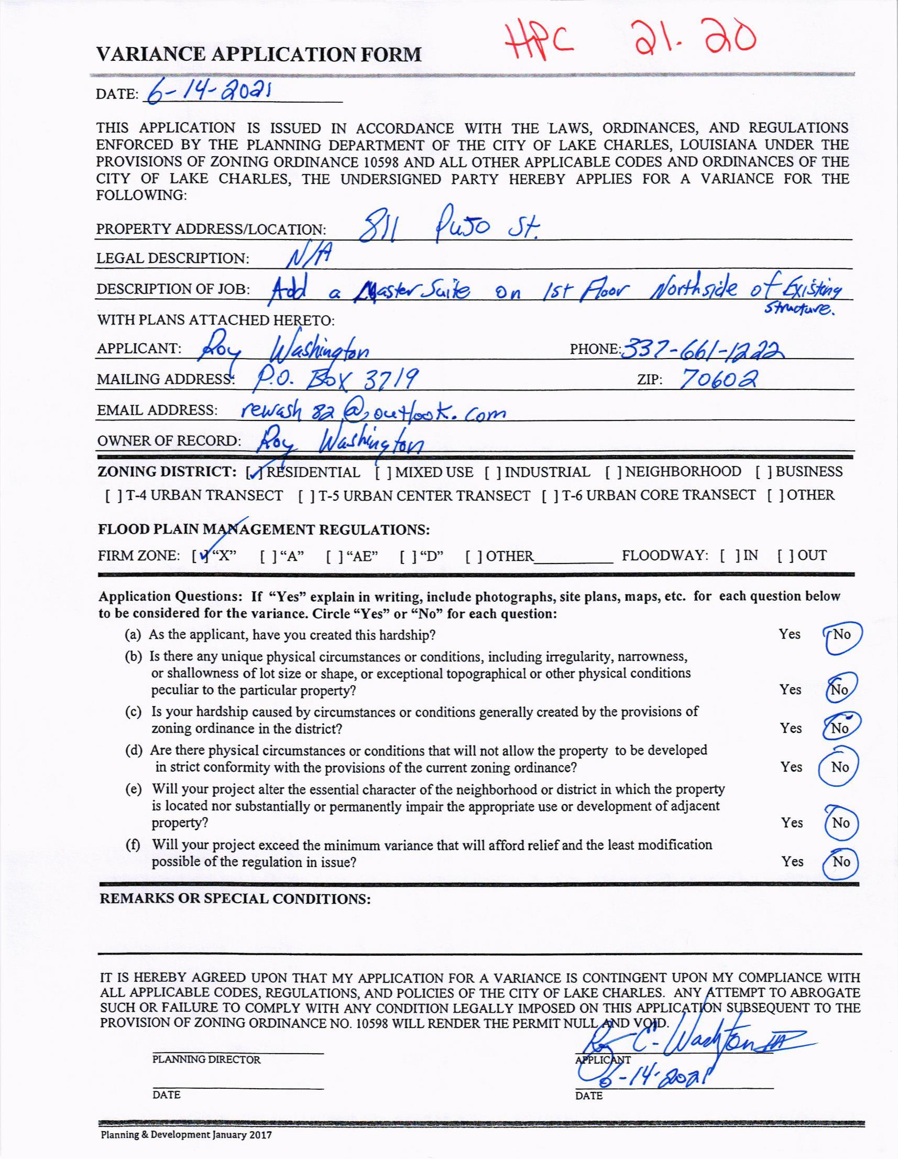
HPC 21-20 811 PUJO ST. ADDITION APPLICATION - WASHINGTON

Slide 40
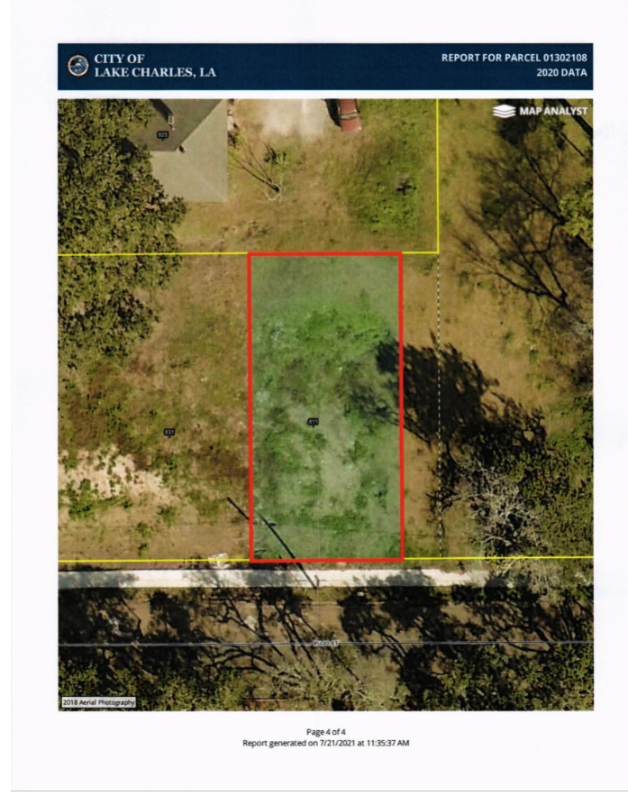
HPC 21-20 811 PUJO ST. - WASHINGTON

Slide 41
HPC 21-20 811 PUJO ST. SITE

Slide 42
HPC 21-20 811 PUJO ST. SITE

Slide 43
HPC 21-20 811 PUJO ST. SITE PLAN FIRST FLOOR PLAN

Slide 44
HPC 21-20 811 PUJO ST. SITE PLAN 2ND FLOOR PLAN

Slide 45
HPC 21-20 811 PUJO ST. SITE PLAN REAR/SIDE ELEVATION

Slide 46
HPC 21-21 LAKE CHARLES ZONING ORDINACE CO. 10598
APPLICANT: 520 PRYCE ST. DIANNA ROSS
SUBJECT: Applicant is requesting a Certificate of Appropriateness (Section 5-307) (15) by the Historic Preservation Commission to build a new single family home, after Hurricane Laura destroyed her old home and the home had to be demolished at 520 PRYCE ST. Neighborhood Zoning
STAFF FINDINGS: The on-site and site plan reviews revealed that the applicant requests to build a new single family home, after Hurricane Laura destroyed her old home and the home had to be demolished at 520 PRYCE ST. Neighborhood Zoning

Slide 47
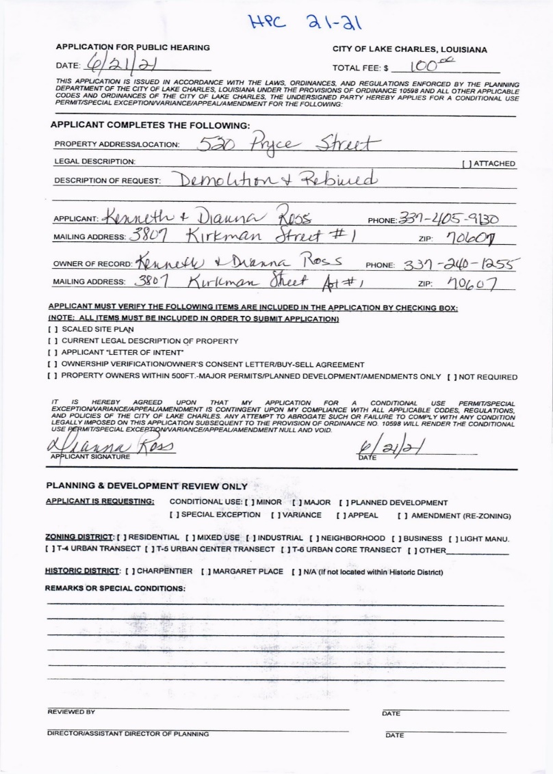
HPC 21-21 520 PRYCE ST - ROSS APPLICATION

Slide 48
HPC 21-21 520 PRYCE ST WINDOWS AND DOORS

Slide 49
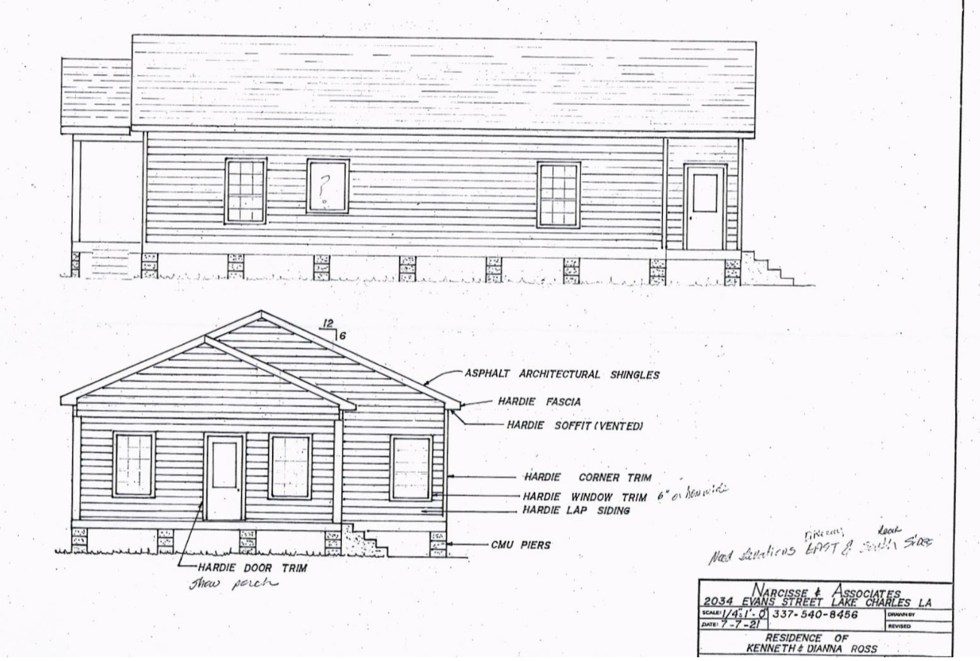
HPC 21-21 520 PRYCE ST - ROSS PLANS

Slide 50
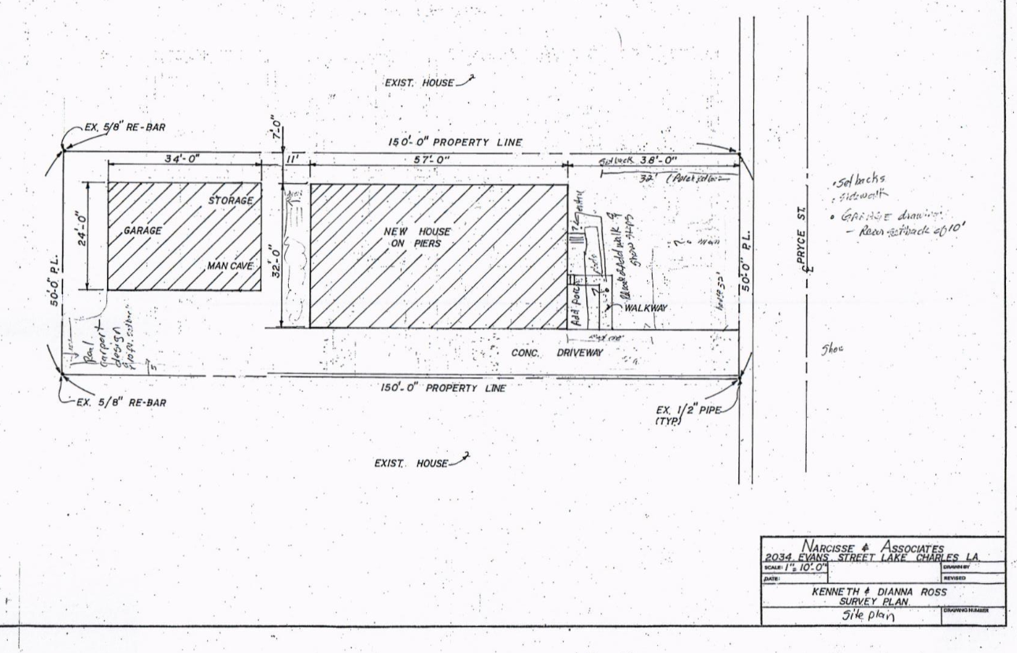
HPC 21-21 520 PRYCE ST - ROSS PLANS

Slide 51
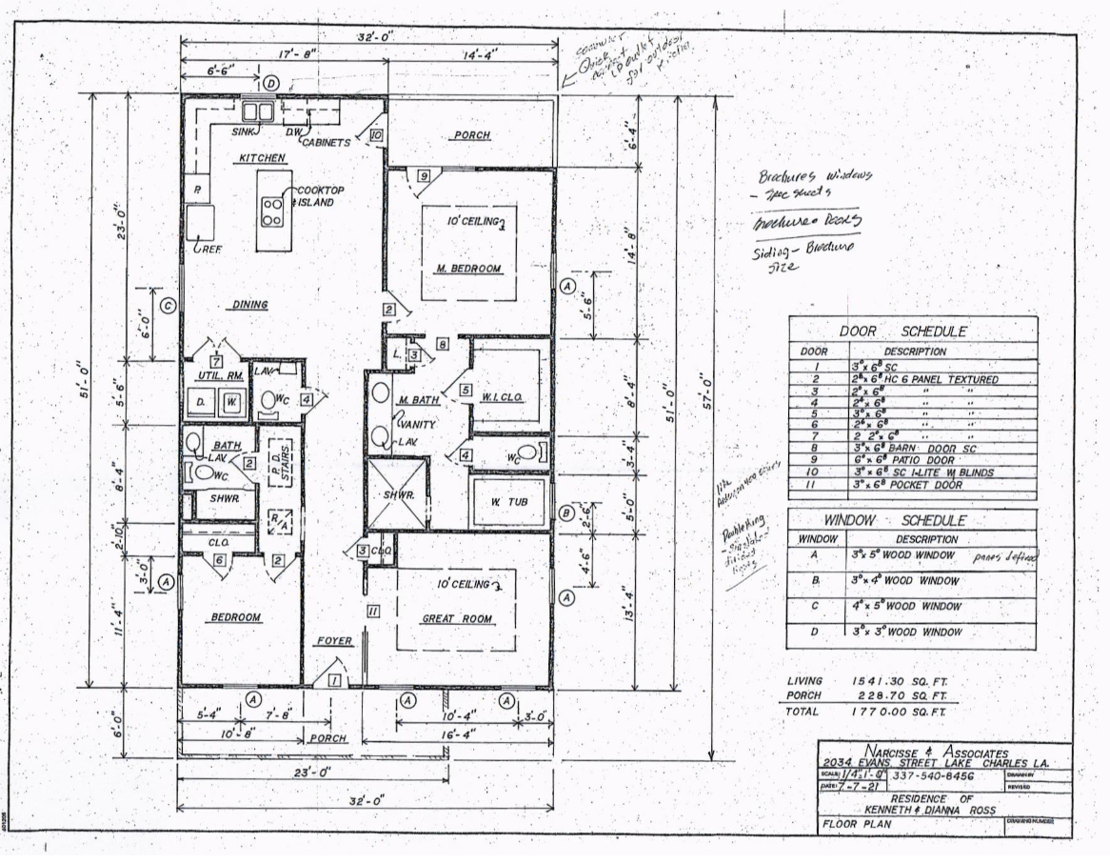
HPC 21-21 520 PRYCE ST - ROSS PLANS

Slide 52
HPC 21-22 LAKE CHARLES ZONING ORDINACE CO. 10598
APPLICANT: 607 PRYCE ST. EDWARD SMITH
SUBJECT: Applicant is requesting a Certificate of Appropriateness (Section 5-307) (15) by the Historic Preservation Commission to construct a new single family home at 607 PRYCE ST Neighborhood Zoning
STAFF FINDINGS: The on-site and site plan reviews revealed that the applicant requests to construct a new single family home. Home will face Pryce Street with Driveway access off Moss. Rear setback will be reduced from 10 feet to 8 feet. Front setback will be 20 feet instead of the 30 feet. These setbacks are similar to the average setbacks measured along the adjacent block faces. 607 PRYCE ST, Neighborhood Zoning

Slide 53
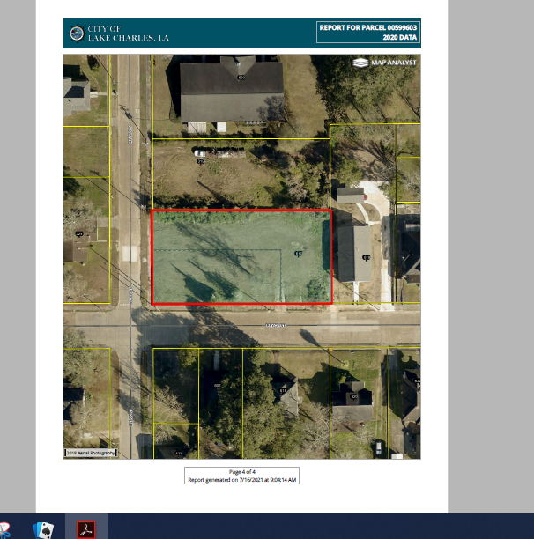
HPC 21-22 607 PRYCE ST - GIS

Slide 54
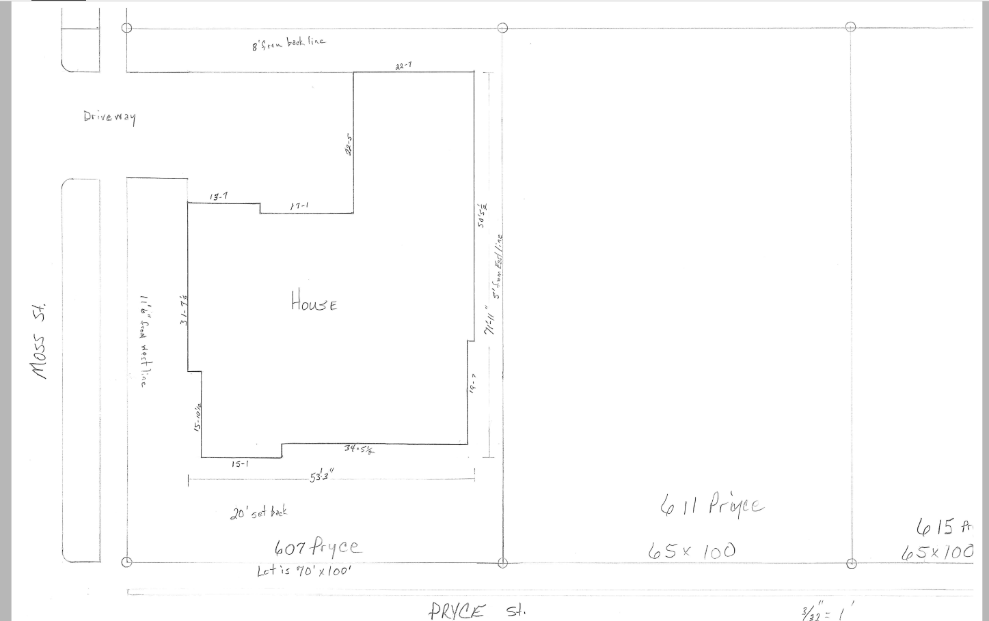
HPC 21-22 607 PRYCE ST - SMITH

Slide 55
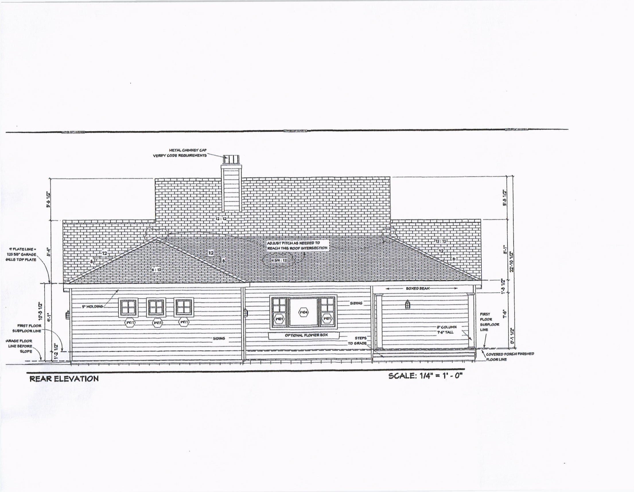
HPC 21-22 607 PRYCE ST – SMITH – PLANS – REAR ELEVATION

Slide 56
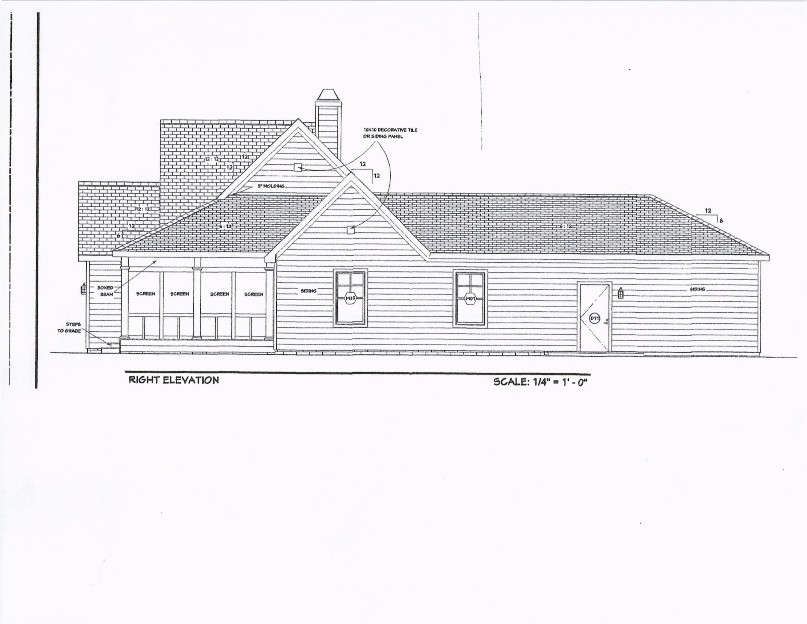
HPC 21-22 607 PRYCE ST – SMITH – PLANS – RIGHT ELEVATION

Slide 57
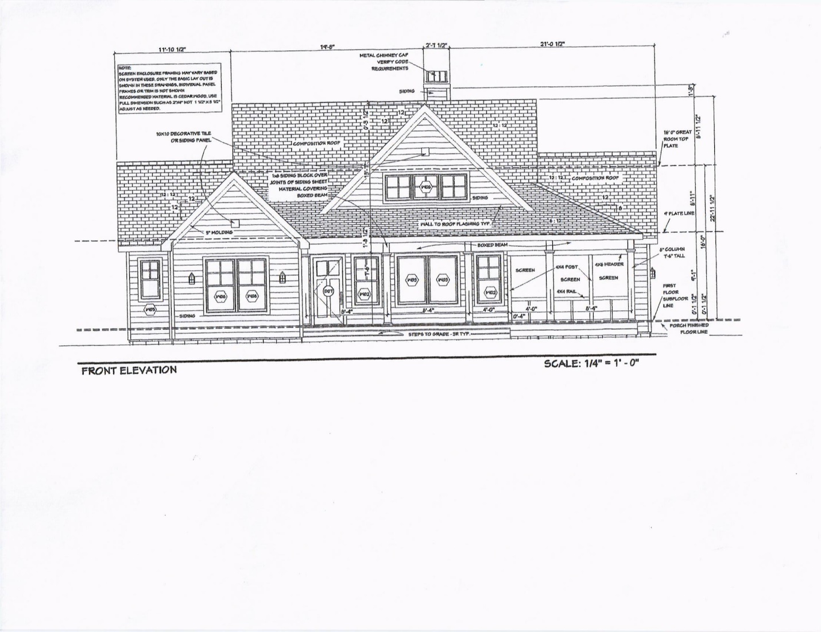
HPC 21-22 607 PRYCE ST – SMITH – PLANS – FRONT ELEVATION

Slide 58
HPC 21-22 607 PRYCE ST – SMITH – BACK DOOR – COLUMN DETAIL

Slide 59
HPC 21-22 607 PRYCE ST – SMITH –FRONT DOOR DENTIL DETAIL

Slide 60
HPC 21-22 607 PRYCE ST – SMITH – ROOF – HARDIE BOARD

Slide 61
HPC 21-22 607 PRYCE ST – SMITH – WINDOWS

