Slide 1
Historic Preservation Commission November 15, 2021
State Authority
CHAPTER 16. HISTORIC PRESERVATION DISTRICTS
PART I. GENERAL PROVISIONS
§731. Purpose
The purpose of this Chapter is to promote the educational, cultural, economic and general welfare of the public through the preservation and protection of buildings, sites, monuments, structures and areas of historic interest or importance through their protection, maintenance and development as historic landmarks and their recognition as such in the history and traditions of the state and nation; to establish and improve property values, and to foster the economic development of the areas affected.
Acts 1970, No. 147, §1. Amended by Acts 1975, No. 804, §1.
Local Authority
Sec. 5-307. - Historic districts and historic landmarks.
(1)
Purposes. It is the purpose of the provisions of this section related to Historic Districts, Charpentier District, and Margaret Place District to recognize, preserve, and protect the cultural and historic resources of the City of Lake Charles by preserving individual landmarks and maintaining and fostering development in areas within the city of special significance to the history and tradition of the city and the region

Slide 2
Historic Preservation Commission
ANY PERSON MAY SPEAK OR SUBMIT A WRITTEN STATEMENT FOR HEARING PURPOSES.
THE APPLICATION AND SUPPORTING MATERIAL IS ON FILE AND OPEN FOR PUBLIC INSPECTION IN THE OFFICE OF ZONING AND LAND USE,
Location of the office is stated below:
7TH FLOOR OF LAKE CHARLES CITY HALL AT 326 PUJO STREET, LAKE CHARLES, LOUISIANA; OR,
MAIL TO THE CITY OF LAKE CHARLES, OFFICE OF ZONING & LAND USE, P.O. BOX 900, LAKE CHARLES, LA 70602; OR
TELEPHONE: (337) 491-1542.

Slide 3
Criteria for Approval of a Certificate of Appropriateness
In considering an application for a Certificate of Appropriateness, the Historic Preservation Commission shall be guided by any adopted design guidelines, and where applicable, the Secretary of the Interior's Standards for Rehabilitation of Historic Buildings.
These documents shall be made available to the property owners of historic landmarks or within historic districts.

Slide 4
Appeals to City Council
An applicant for a Certificate of Appropriateness, or any City Council member, dissatisfied with the action of the Historic Preservation Commission relating to the issuance or denial of a Certificate of Appropriateness shall have the right to appeal to the City Council within 15 days after receipt of notification of such action.
The City Council shall give notice, follow publication procedures, hold hearings, and make its decision in the same manner as provided in the general zoning ordinance of the city. In hearing an appeal, the City Council shall determine whether the proposed work is consistent with the regulations, standards, and design guidelines contained in this Ordinance.

Slide 5
Additional reports and design review updates:
HPC 21-02 1911 City Hall – Randy Goodloe AIA Updates for the Storm Repairs
HPC 21-01 Central School – Randy Goodloe AIA Updates for the Storm Repairs
MATT YOUNG – Programs @ 1911 City Hall
CLG Grant “Hurricane Harvey” property survey ,Sara Hahn of Coastal Environs. Progress reports

Slide 6
Announcements
NPS LA CRT CLG “Harvey Grant” - Survey Update: Grant award $100,000, SOI qualified consultant Sara Hahn of Coastal Environmental
CLG grant Digitization Phase 2 awarded Will begin when contracted Est. Dec 2021
Overview of Hurricane recovery, property data and administrative reviews
Updates Central School –
Updates 1911 Old City Hall –

Slide 7
HPC 21-19 328 HODGES - NATHANIEL BRYANT
HPC 21-19 LAKE CHARLES ZONING ORDINANCE CO. 10598
APPLICANT: 328 HODGES STREET NATHANIEL BRYANT
SUBJECT: Applicant is requesting a Certificate of Appropriateness (Section 5-307) (15) by the Historic Preservation Commission to replace lower existing siding with treated plywood, Tyvek, and hardy plank siding at 328 HODGES ST. Neighborhood Zoning
STAFF FINDINGS: The on-site and site plan reviews revealed that the applicant requests to replace lower existing siding with treated plywood, Tyvek, and hardy plank siding
328 HODGES ST. Neighborhood Zoning – Contributing Element

Slide 8
HPC 21-19 328 HODGES - NATHANIEL BRYANT GIS MAP

Slide 9
HPC 21-19 328 HODGES ST - NATHANIEL BRYANT – GIS MAP

Slide 10
HPC 21-19 328 HODGES ST – BRYANT – APPLICATION

Slide 11
HPC 21-19 328 HODGES ST – BRYANT – HARDY BOARD PLANKS

Slide 12
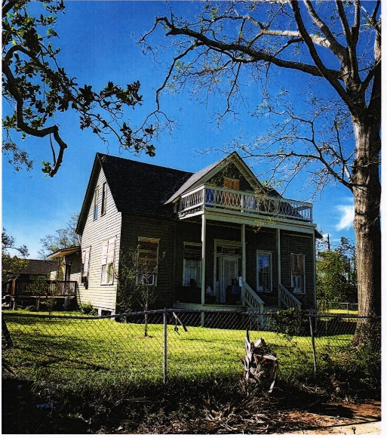
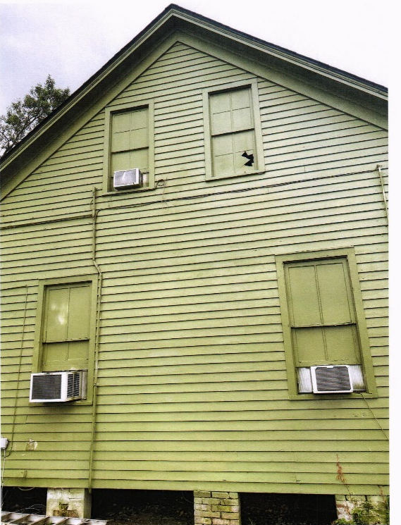
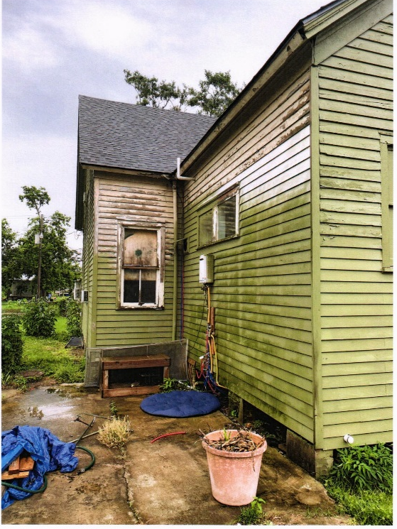
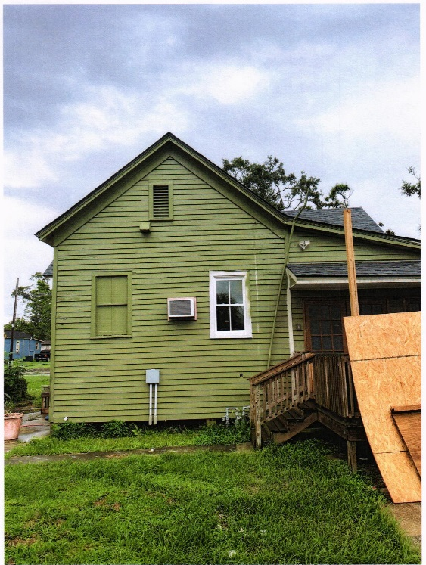
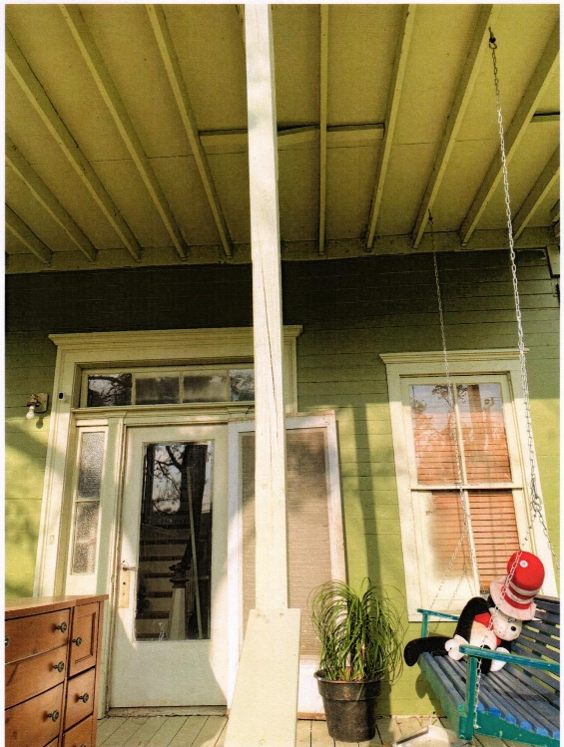
HPC 21-19 328 HODGES ST HARDY BOARD SIDING

Slide 13
HPC 21-19 328 HODGES ST - NATHANIEL BRYANT

Slide 14
HPC 21-19 328 HODGES ST - NATHANIEL BRYANT

Slide 15
HPC 21-24 625 MILL ST - HENRY DELGADO
HPC 21-24 LAKE CHARLES ZONING ORDINANCE CO. 10598
APPLICANT: 625 MILL ST - HENRY DELGADO
SUBJECT: Applicant is requesting a Certificate of Appropriateness (Section 5-307) (15) by the Historic Preservation Commission to replace lower existing siding with treated plywood, Tyvek, and hardy plank siding at 625 MILL ST Neighborhood Zoning
STAFF FINDINGS: The on-site and site plan reviews revealed that the applicant requests to include replacing all the windows in the home. The amount of windows that will be replaced will be 18. Three windows on front of house, five windows on one side of the house, seven windows on the other side of the house. Three windows on the back of the house. Window world product is the 400 DH Fusion Weld for all windows with Flat/Contoured grids that is very similar if not exact grids on the current windows. 625 MILL STREET, Neighborhood Zoning.

Slide 16
HPC 21-24 625 MILL ST - HENRY DELGADO GIS MAP

Slide 17
HPC 21-24 625 MILL ST - HENRY DELGADO GIS MAP

Slide 18
HPC 21-24 625 MILL ST - HENRY DELGADO LETTER OF INTENT

Slide 19
HPC 21-24 625 MILL ST - HENRY DELGADO WINDOWS

Slide 20
HPC 21-24 625 MILL ST - HENRY DELGADO WINDOWS

Slide 21
HPC 21-24 625 MILL ST - HENRY DELGADO WINDOWS

Slide 22
HPC 21-24 625 MILL ST - HENRY DELGADO WINDOWS

Slide 23
HPC 21-24 625 MILL ST - HENRY DELGADO HOME /WINDOWS

Slide 24
HPC 21-24 625 MILL ST - HENRY DELGADO HOME /WINDOWS

Slide 25
HPC 21-24 625 MILL ST - HENRY DELGADO HOME /WINDOWS

Slide 26
HPC 21-24 625 MILL ST - HENRY DELGADO HOME /WINDOWS

Slide 27
HPC 21-24 625 MILL ST - HENRY DELGADO HOME /WINDOWS

Slide 28
HPC 21-24 625 MILL ST - HENRY DELGADO HOME /WINDOWS

Slide 29
Next Regular meeting date December 20, 2021

Slide 30
2022 HPC MEETING SCHEDULE
JANUARY 18, 2022 TUESDAY
FEBRUARY 21, 2022 MONDAY
MARCH 21, 2022 MONDAY
APRIL 18, 2022 MONDAY
MAY 16, 2022 MONDAY
JUNE 20, 2022 MONDAY
JULY 18, 2022 MONDAY
AUGUST 15, 2022 MONDAY
SEPTEMBER 19, 2022 MONDAY
OCTOBER 17, 2022 MONDAY
NOVEMBER 21, 2022 MONDAY
DECEMBER 19, 2022 MONDAY

